Slide 1
BRAIN TUMOUR CLASSIFICATION
CS 6350 BIG DATA MANAGEMENT AND ANALYTICS
Group Project Presentation

Slide 2
AGENDA
Introduction
Data
Pre-processing
Algorithm
Results
Summary

Slide 3
INTRODUCTION
Semi-Supervised Learning has been increasing in popularity for image classification due to not needing as many labels.
Image Classification is performed on MRI scans with brain tumors using semi-supervised learning.
The models are pre-trained using contrastive learning to improve accuracy on new images.

Slide 4
DATA -PREPROCESSING
Dataset: 7023 MRI scans from 3 sources
Training: 5712 images
Testing: 1311 images
Classes: glioma, meningioma, pituitary, no tumor
Preprocessing: Cropped to remove noise
Grayscale conversion
Margin threshold, erosion, dilation
Cropped using pixel boundaries
Resized to 256 x 256 pixels
Training data split:
Unlabeled set: 286 images (5%)
Labeled set: 5426 images (95%)

Slide 5
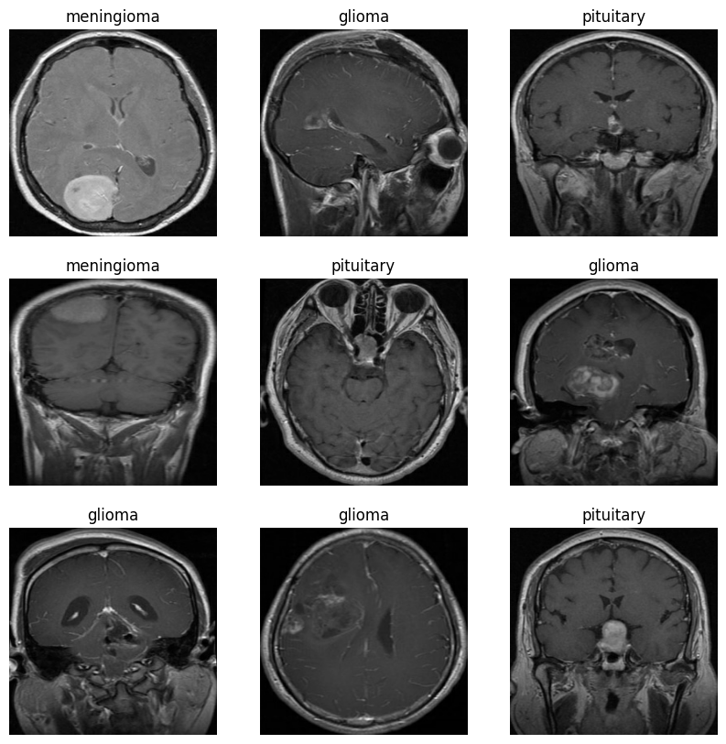
Fig. 1. Some examples of images from the dataset along with their classes.

Slide 6
SSL Model with Contrastive Pretraining- I
1. Model Components:
Encoder: Uses Conv2D layers to encode image representations.
Augmenter: Performs random horizontal flip, vertical, and horizontal shift.
Weak Augmentation: Alters 13% of the image.
Strong Augmentation: Alters 50% of the image.
Non-linear Projection Head: Enhances encoder's representations.
Linear Probing Layer: Used as a performance metric.
2. Performance Metrics:
Contrastive Accuracy (based on SimCLR): Measures similarity between augmented and other images.
Linear Probing Accuracy: Measures accuracy of a logistic regression classifier on encoder's features.
Utilizes SparseCategoricalAccuracy metric.

Slide 7
SSL Model with Contrastive Pretraining-II
3. Loss Functions:
InfoNCE (Information Noise-Contrastive Estimation): Minimized during training.
NT-Xent (Normalized Temperature-Scaled Cross Entropy): Minimized during training.
Loss computed by comparing representations of an image to all possible pairs using cosine similarity.
4. Model Training:
20 epochs of training.
Adam optimizer used for finetuning the model.
Test step predicts classes on testing data after each epoch.
Initial model and finetuned model both trained.

Slide 8
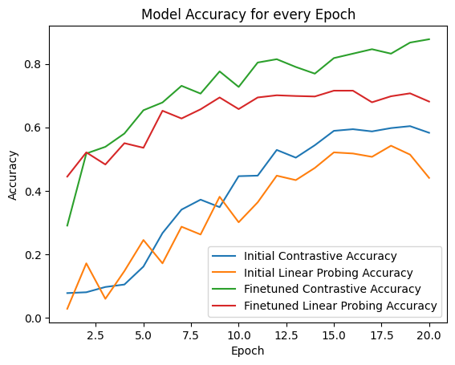
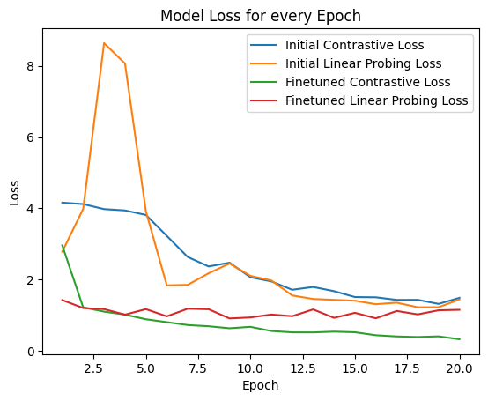
RESULTS-I
Fig. 2. Contrastive and linear probing accuracies for the initial and finetuned model across 20 epochs.
Fig.3. Contrastive and linear probing losses for the initial and finetuned model across 20 epochs.

Slide 9
RESULTS-II
Training accuracy improves significantly after training for 20 epochs.
There is a large performance improvement for the finetuned model from the initial model.
The peak training accuracy reaches 87.76% for the finetuned model but only 60.37% for the initial model.
A peak testing accuracy of 54.61% for the initial model and a peak testing accuracy of 71.55% on our finetuned model, indicating a big performance jump after finetuning.

Slide 10
SUMMARY
The project aims to apply SSL with contrastive pretraining to improve brain tumor classification using MRI scans.
The model architecture, featuring an encoder, augmenter, and non-linear projection head, played a vital role in enhancing the quality of image representations.
Contrastive accuracy and linear probing accuracy were reliable performance metrics, indicating the model's ability to learn meaningful representations and classify brain tumors effectively.
Data preprocessing techniques, such as noise removal and resizing, ensured consistent and high-quality input images, contributed to improved model performance.
After 20 epochs of training and finetuning, the model demonstrated significant improvements in accuracy, surpassing the performance of the initial model.

Slide 11
THANK YOU
Shanmukha Bodapati
Arya Sawant
Sarthak Gaur
Mehak Lnu

